Slide 1
Physics for Scientists and Engineers
Paul A. Tipler • Gene Mosca
Fifth Edition
Chapter 37:
Molecules
Copyright © 2004 by W. H. Freeman & Company

Slide 2
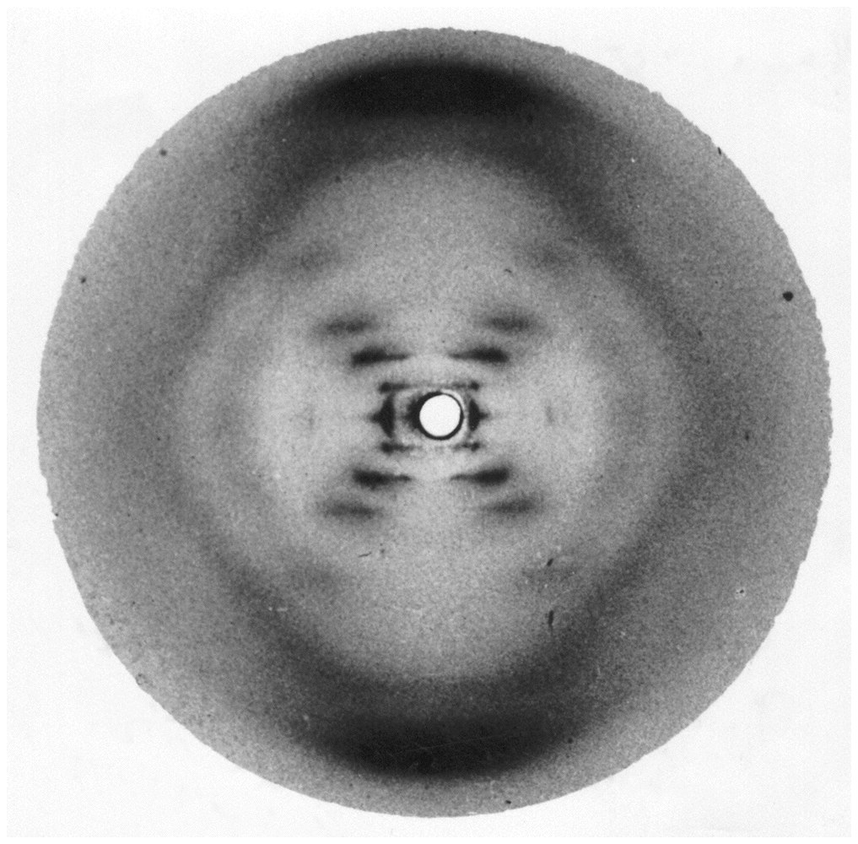

Slide 3
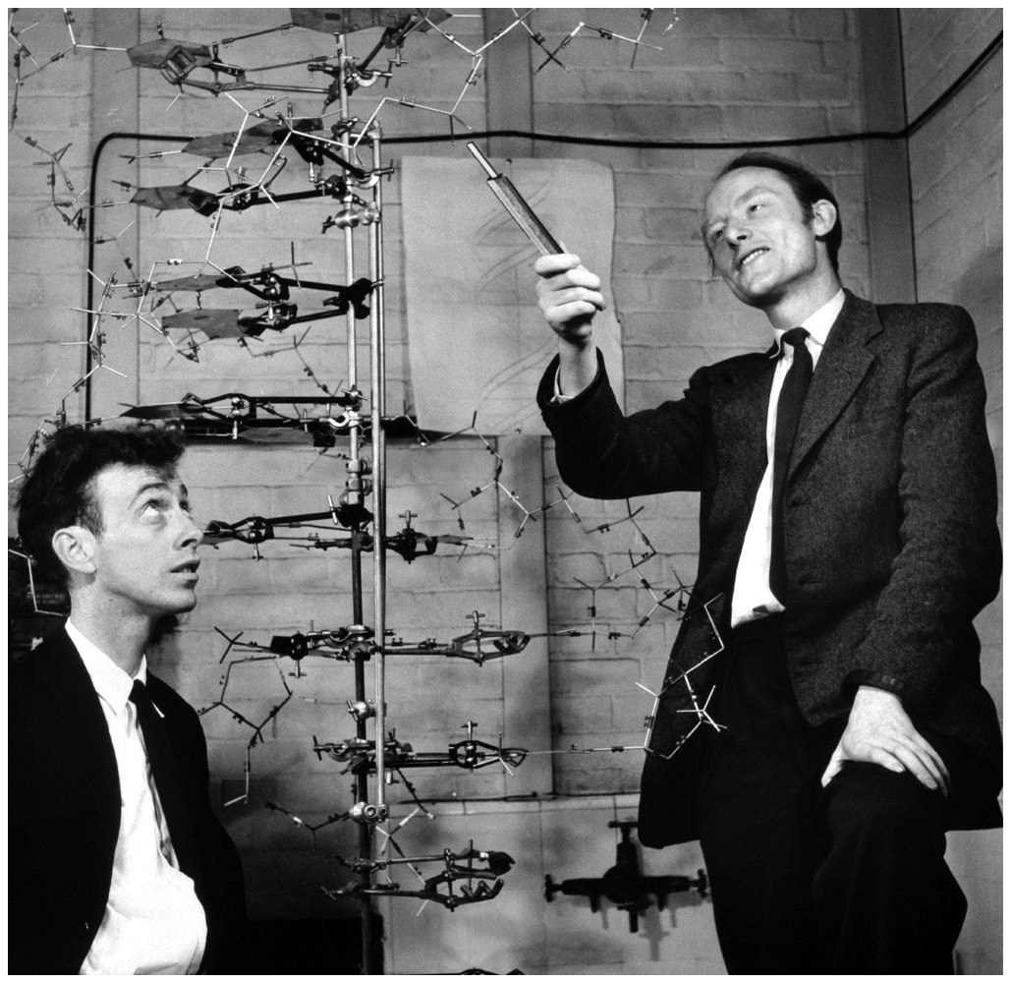

Slide 4
37-1
Molecular Bonding

Slide 5
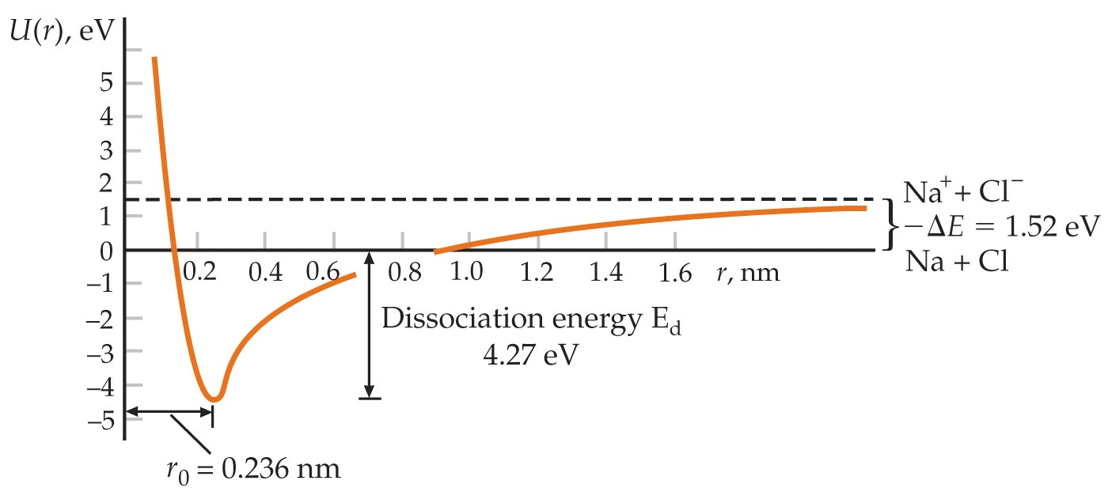

Slide 6
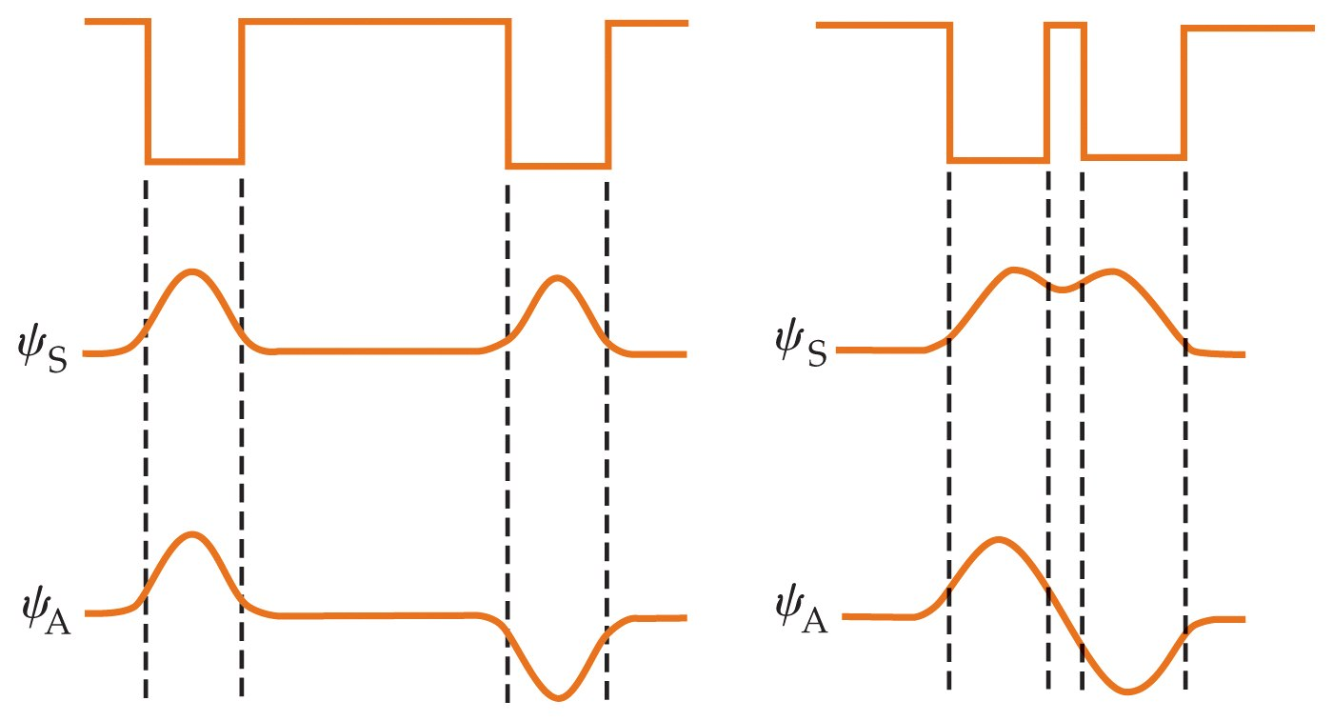

Slide 7


Slide 8
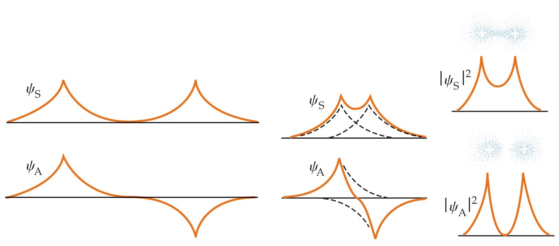

Slide 9
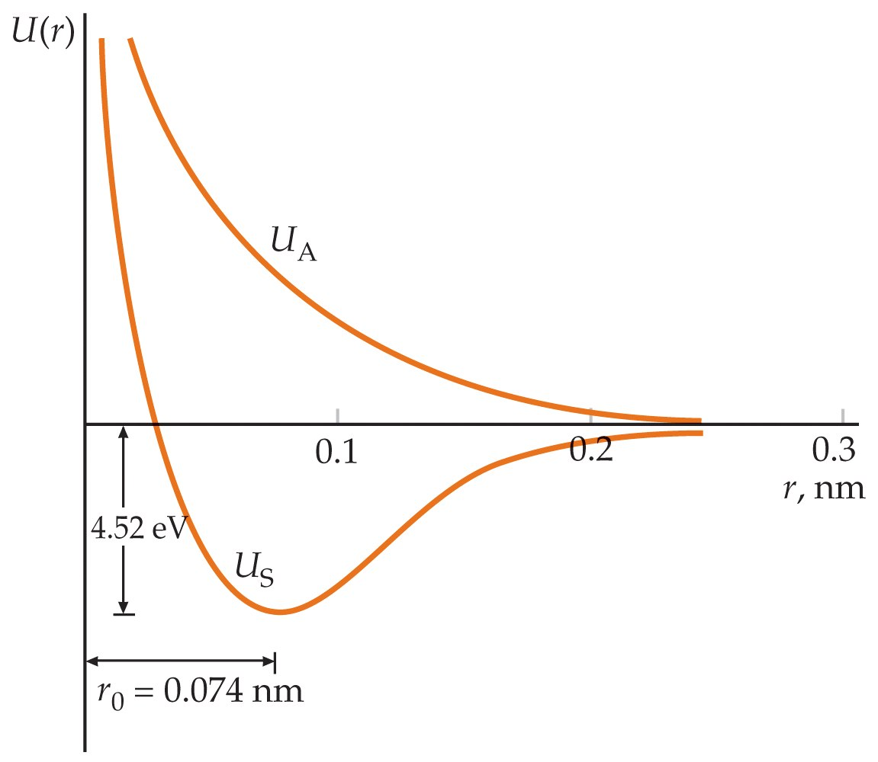

Slide 10
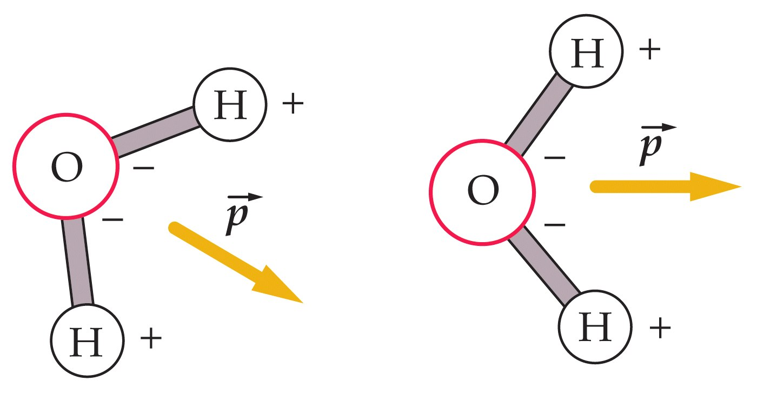

Slide 11
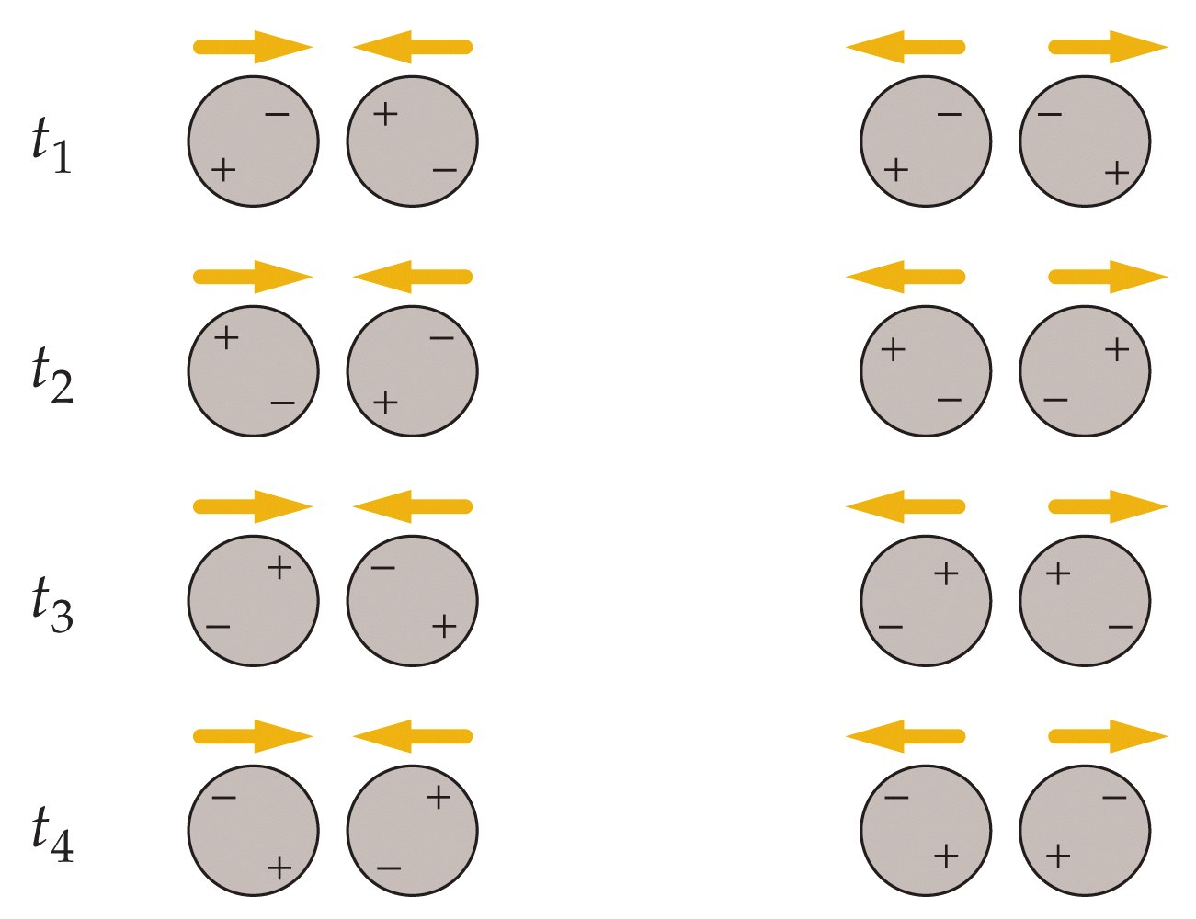

Slide 12
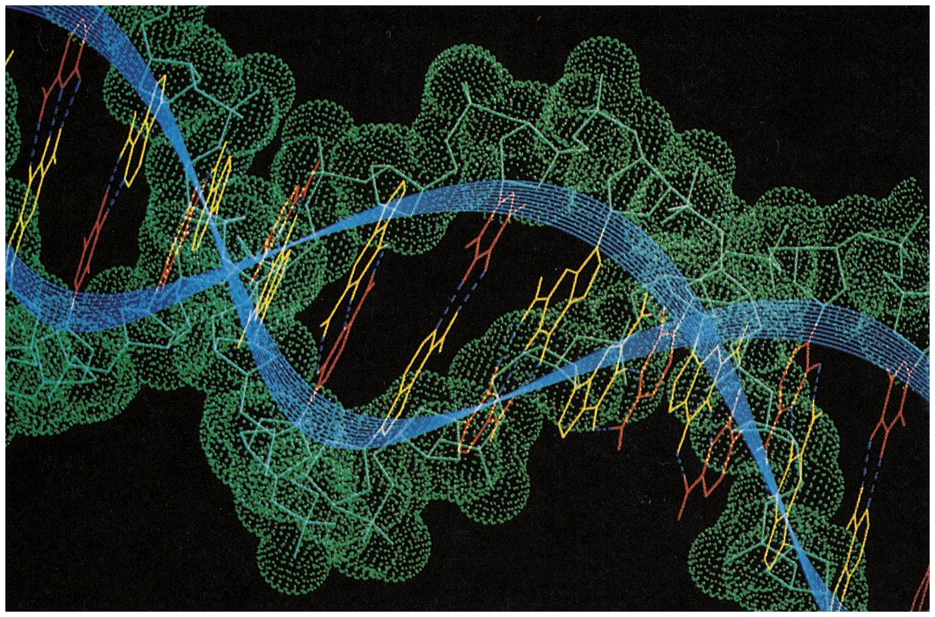

Slide 13
37-2
Polyatomic Molecules

Slide 14
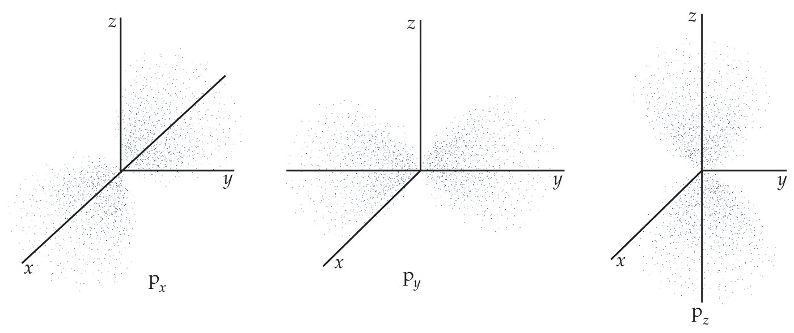

Slide 15
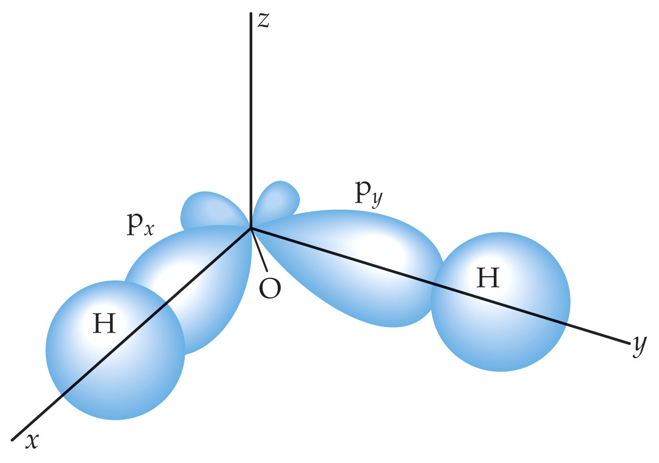

Slide 16
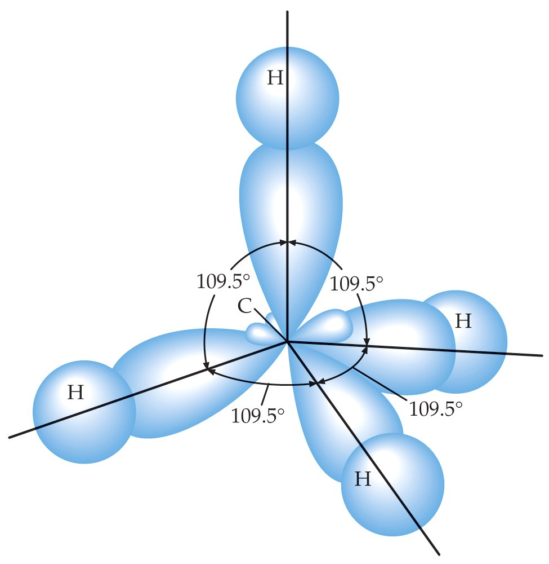

Slide 17
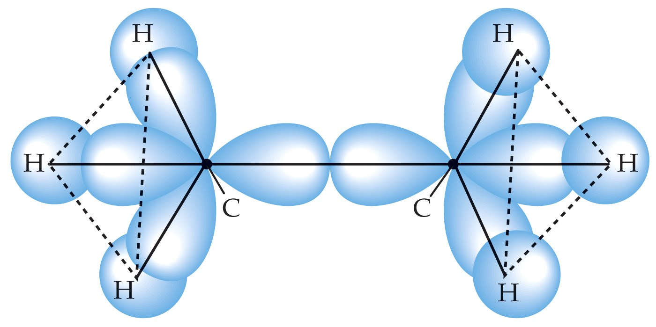

Slide 18
37-3
Energy Levels and Spectra of Diatomic Molecules

Slide 19
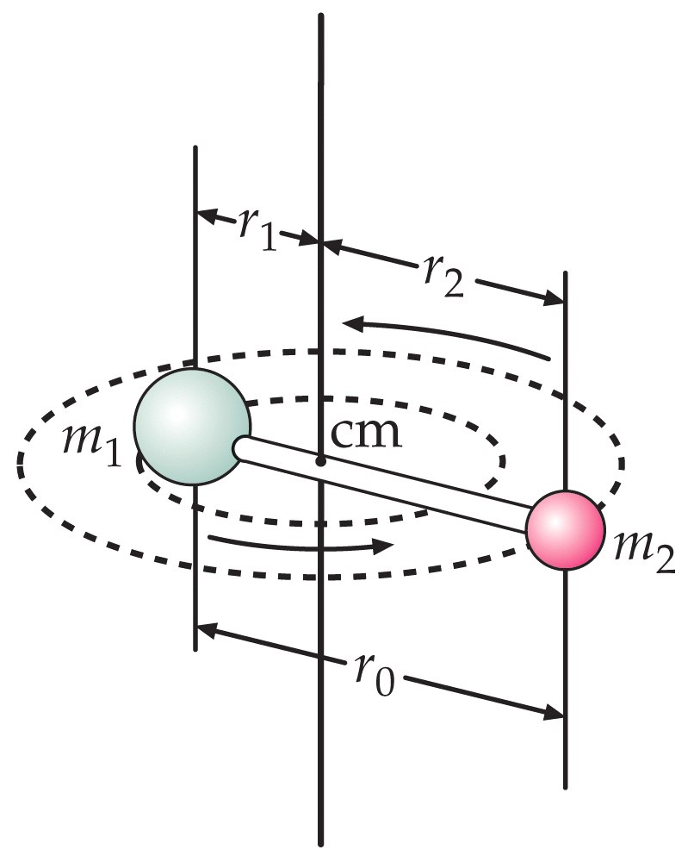

Slide 20


Slide 21
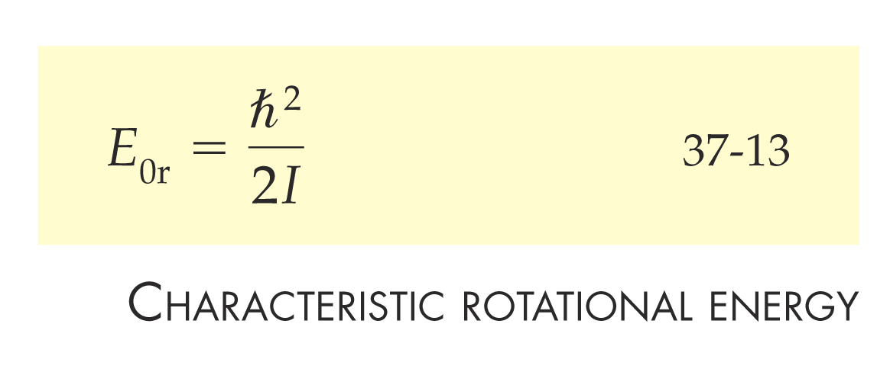

Slide 22
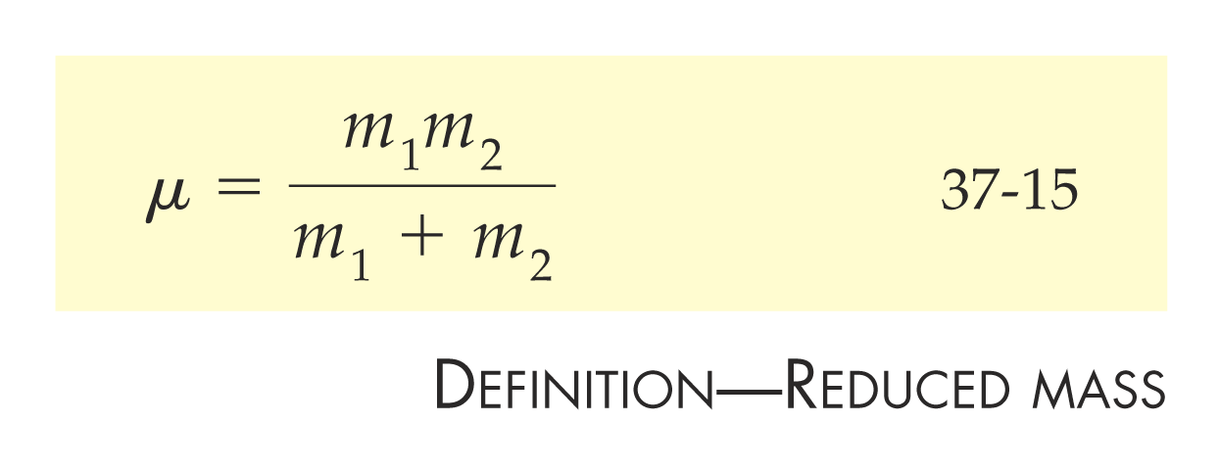

Slide 23


Slide 24
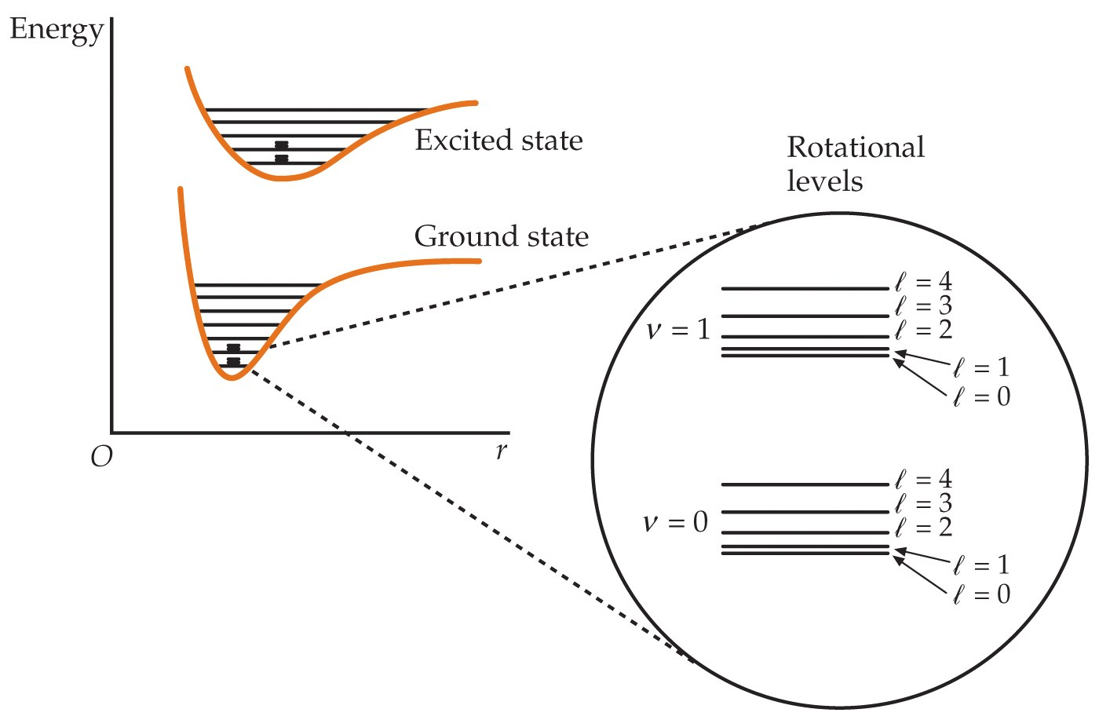

Slide 25


Slide 26
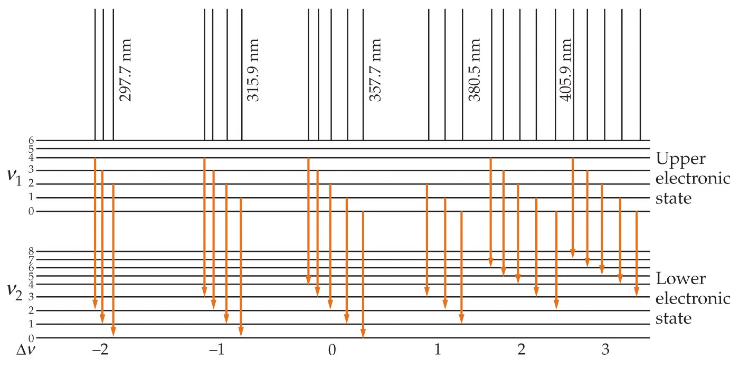

Slide 27


Slide 28
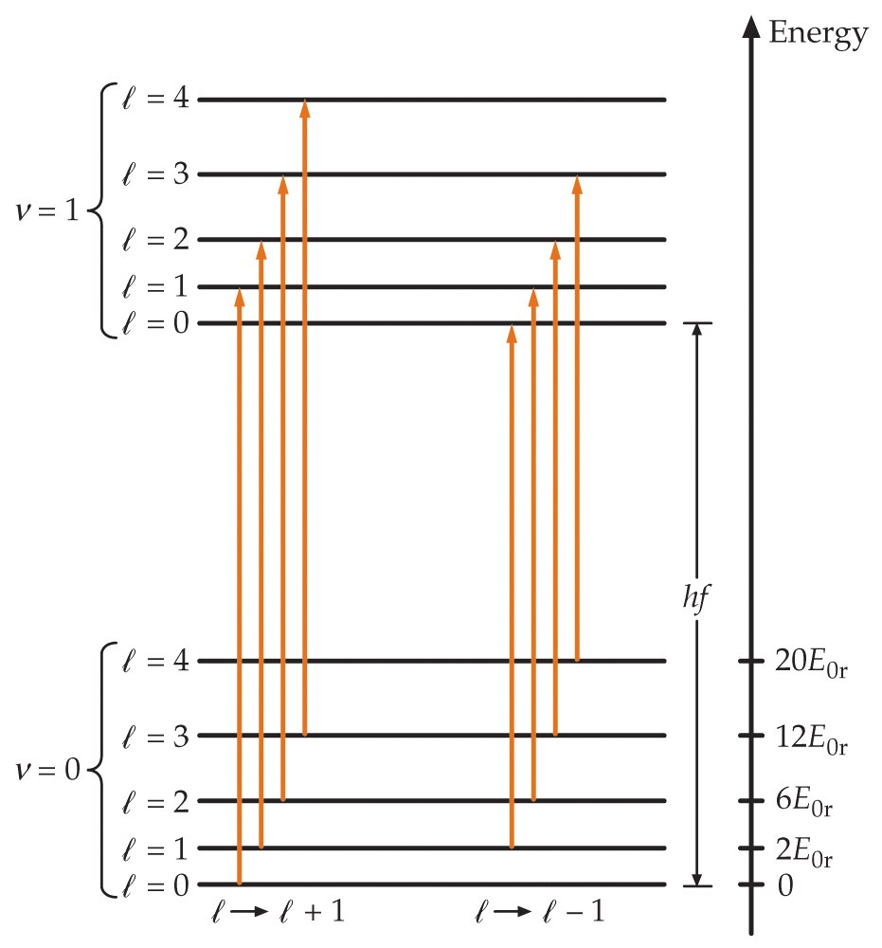

Slide 29
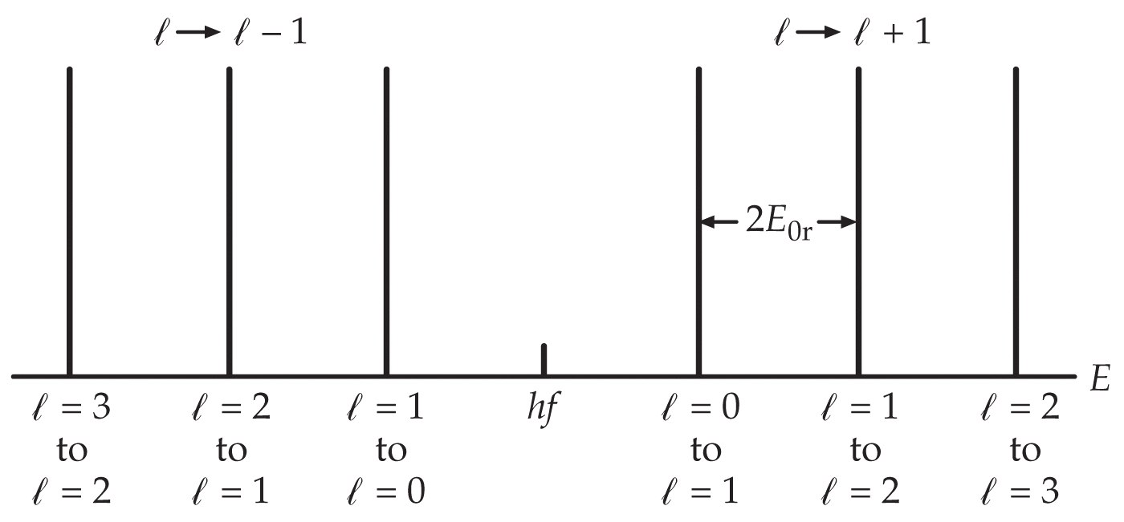

Slide 30
